Slide 1



CA IS113 Code Clinic {
CA2.html
clinic.php
[HTML & PHP]
$instructor = ‘Bryan’;
$timing = ‘1400 - 1700’;
}
Programming Language

Slide 2
Table Of ‘Contents’ {
01
02
03
CA2.html
clinic.php
Code Recap (1400 - 1440)
Hands-On Exercises (1440 - 1630)
Go Through (1630 - 1700)
}
Programming Language

Slide 3
01 {
[Code Recap]
CA2.html
clinic.php
HTML Recap
PHP Recap
Form Processing
}
Programming Language

Slide 4
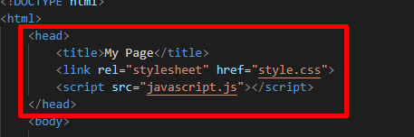
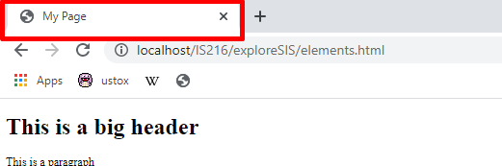
CA2.html
clinic.php
HTML - Structure {
Head
Webpage Title
Links CSS and Javascript files for usage.
NOT displayed on your webpage.
Used for containing specific data about webpage (metadata), and link scripts and files that support webpage display.
}
Programming Language

Slide 5
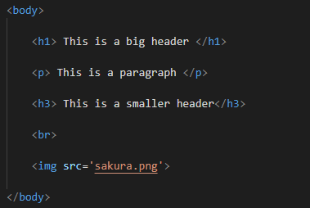
CA2.html
clinic.php
HTML - Structure {
Body
Contains the HTML Elements that are meant to be visible on your webpage.
Used for rendering HTML Elements and text on your browser.
You will be coding here often for WAD1.
}
Programming Language

Slide 6
CA2.html
clinic.php
HTML - Elements {
Text Formatting, Headers, Paragraphs
<strong></strong>
<h1></h1>
<p></p>
}
Programming Language

Slide 7
CA2.html
clinic.php
HTML - Elements {
Images & Anchors
<img>
<a></a>
Have attributes that are needed to function
E.g. <img src=’images/photo.png’>
E.g. <a href=’google.com’>Click</a>
}
Programming Language

Slide 8
CA2.html
clinic.php
HTML - Elements {
Lists
<ul></ul>
<ol></ol>
<li> </li> elements to put stuff in a list
}
Programming Language

Slide 9
CA2.html
clinic.php
HTML - Elements {
Tables
<table></table> - defines the table
<tr></tr> - defines table row
<td></td> - defines a table cell in a row
}
Programming Language

Slide 10
CA2.html
clinic.php
PHP - Syntax & Form Processing {
Refer to VSC code
}
Programming Language

Slide 11
02 {
[Hands-On Coding]
CA2.html
clinic.php
}
Programming Language
Notes:
https://docs.google.com/document/d/1mq8B_8ydziQ1uadGMsqt5-0aLgrlr714wVpex5gGB-Q/edit?usp=sharing

Slide 12
03 {
[Go Through Questions]
CA2.html
clinic.php
}
Programming Language

Slide 13
CA2.html
clinic.php
Tips for WAD1 {
Get used to the new syntax of PHP
Use var_dump to test the output of your codes.
Always check the format of your webpage.
READ THE QUESTION!!! ($_GET or $_POST?)
}
Programming Language

Slide 14
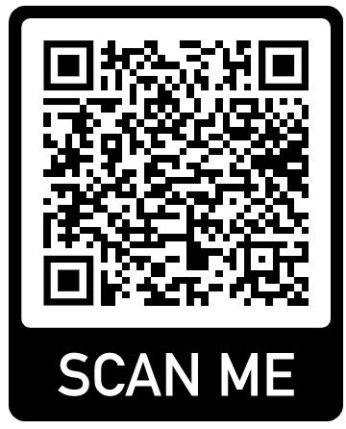
Thank you! {
CA2.html
clinic.php
Scan the Feedback Form.
}
Programming Language
Notes:
https://smu.sg/CA2ClinicFeedback

